Slide 1

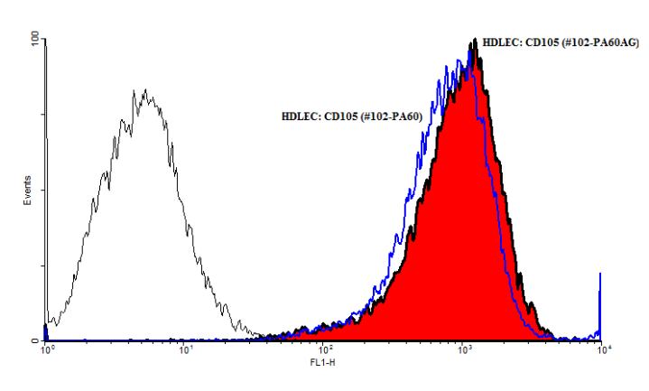
ReliaTech GmbH
Rabbit anti-human CD105)
(Cat #102-PA60 / 102-PA60AG)
Fig. 1: FACS analysis with primary human dermal lymphatic endothelial cells (HDLEC).
http://www.reliatech.de / orders@reliatech.de

